Slide 1
Testing Real-Time Software Systems
Notes:
1

Slide 2
Overview – What is a real-time system?
Must respond to external input within a finite and specified period of time
Often are embedded systems, designed for a dedicated platform and application
Sometimes called reactive systems because they react to changes in their environment (the other systems and processes they interact with)‏
Notes:
2

Slide 3
Real-Time Software Systems

Slide 4
Types of real-time tasks
Periodic tasks – activated at a fixed frequency
Aperiodic tasks – can be activated at any point in time
Must have a constraint on activation pattern to achieve real-time timeliness
Example constraint: a minimum inter-arrival time, denoting the minimum time between two activations of the task
Notes:
4

Slide 5
What are we looking for when testing?
Timeliness – the ability of the software to meet time constraints
Worst-case execution time
Response time – the time between activation of a task and its completion
Notes:
5

Slide 6
Issues in testing real-time systems
Observability
For real-time software, this is the ability to log or monitor the behavior of the system
Usually accomplished by using probes to reveal information about current state and state changes
Notes:
6

Slide 7
Issues in testing real-time systems
Reproducibility
Difficult to achieve in real-time systems, because real-time systems are largely nondeterministic
Example: Response time depends on current system load, hardware components, etc.
May need to use statistical methods to ensure valid test results – usually by executing the program using the same input many times to get statistically significant data
Notes:
7

Slide 8
Timeliness faults, errors, and failures
Timeliness fault – a mistake in the implementation or configuration of a real-time system that results in incorrect temporal behavior
Example: An error in a loop condition that causes it to iterate more times than expected
Can also occur if some part of the environment behaves unexpectedly
Notes:
8

Slide 9
Timeliness faults, errors, and failures
Timeliness error – the system internally deviates from assumptions about its temporal behavior
Similar to internal state errors
Often hard to detect without extensive logging
Timeliness fault – violation of a time constraint that can be observed externally
Usually easily detected, since constraints usually relate to the external behavior of the system

Slide 10
Testing Timeliness
Often difficult to use standard test criteria, since they rarely consider real-time information in test case generation
Traditionally timeliness is analyzed via scheduling analysis or regulated via admission control schemes
For these to work, assumptions about tasks and activation patterns must always be maintained
Analysis is often complex
Challenge is to find the inputs that will cause faults

Slide 11
Testing Timeliness
Typically, testing uses formal models of the software
Constraint graphs – used to specify time constraints on system inputs
Temporal logic – test case elements are pairs of timed inputs and outputs, which can then be combined and shifted in time to create many test cases. However, the number of pairs needed expands quickly as the program complexity increases (size, number of constraints, etc.)‏

Slide 12
Testing Timeliness
Timed automata – verifies sequences of timed action transactions via reliability analysis to determine which transactions should be tested. Again suffers from rapid expansion of states for large programs, which can be reduced somewhat using various sampling techniques.
These and other modeling approaches are generally based on graph criteria

Slide 13
Testing Timeliness
Another approach based on mutation testing
Potential faults modeled as mutation operators, goal is to find those that have the potential to violate timeliness so test cases can be constructed for those mutants
Examples:
Task set mutation operator: changes the point in time when a resource is taken
Precedence constraint mutation operator: adds/removes precedence relations between pairs of tasks

Slide 14
An Example of A Real-Time Reactive System

Slide 15
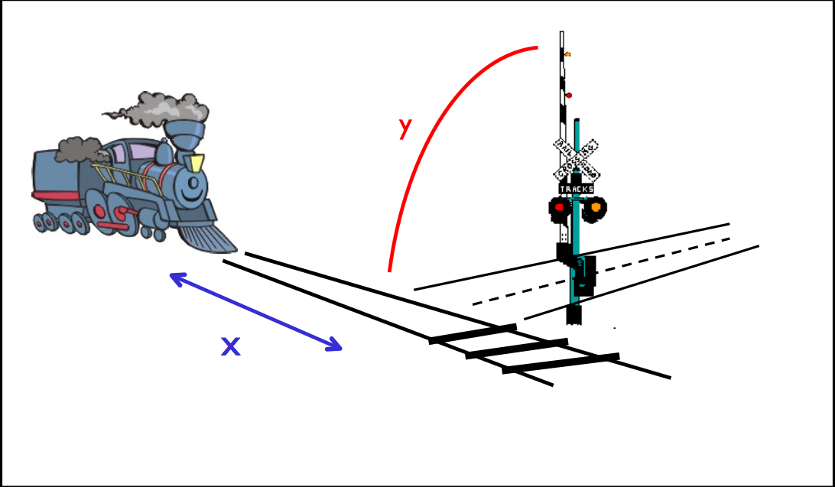
A Bench-mark Example

Slide 16
Railroad Crossing
Several trains may cross one or more gates independently and simultaneously using non-overlapping tracks
A train chooses the gate it intends to cross, and sends a request for entering the gate.
The controlling system monitoring that gate receives the message and closes the gate. The system monitors the gate until no more train remains, then opens the gate

Slide 17
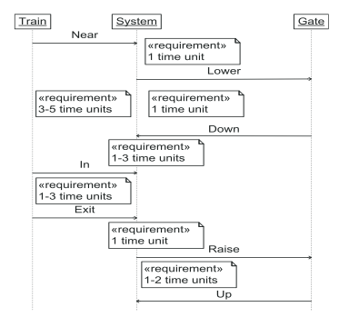
Scenario for “One Train, One gate and One Controller”

Slide 18
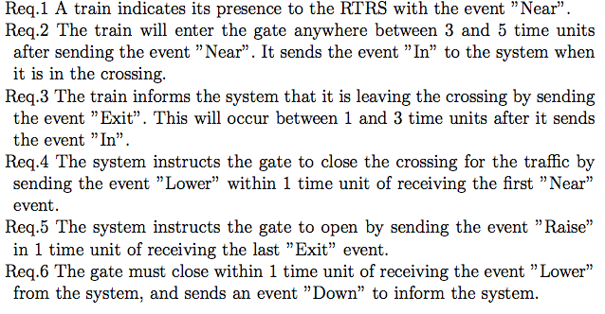
Timing Constraints

Slide 19
Timing Constraints –cont.

Slide 20
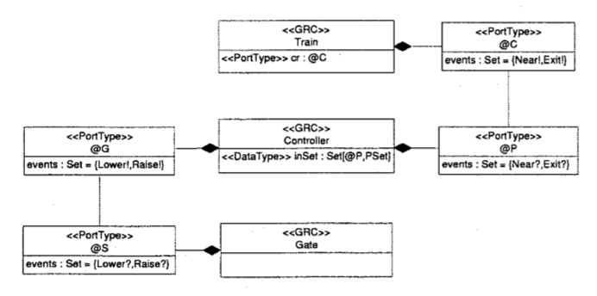
Class Diagram

Slide 21
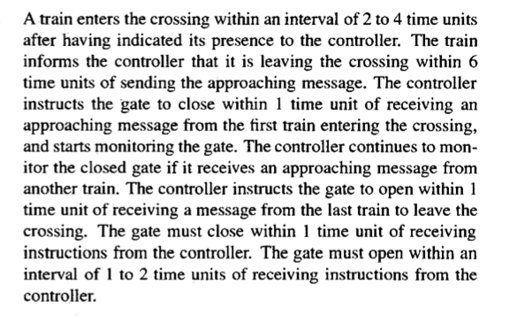
Details

Slide 22
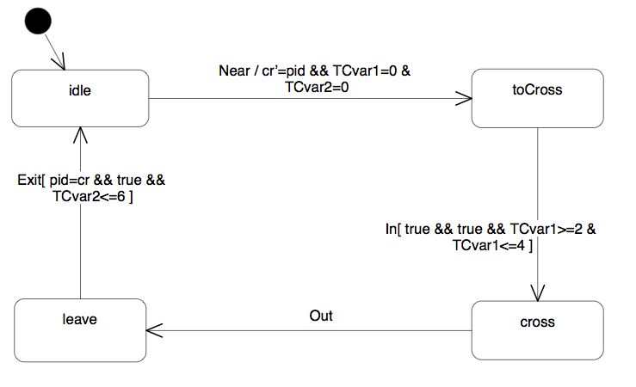
Finite State Machine for Train

Slide 23
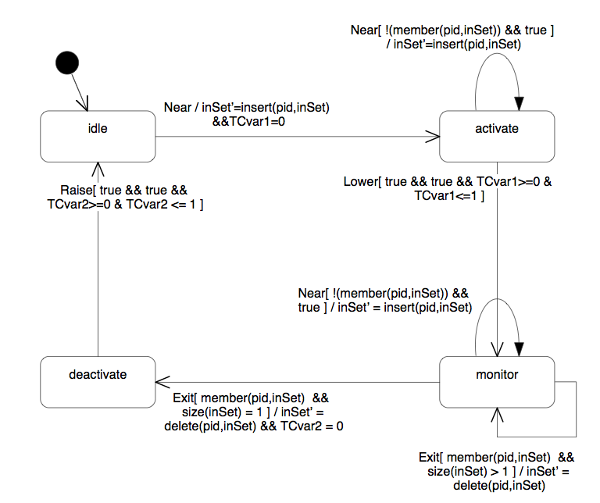
Finite State Machine for Controller

Slide 24
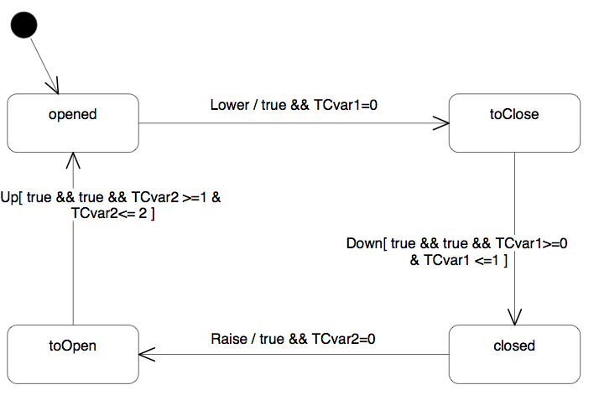
Finite State Machine for Gate
Notes:
The design of the arbiter ensures the satisfaction of safety and liveness properties. Two middle and leftlane controllers hold the resource concurrently onlywhen the two lanes are compatible. This ensures thatcollision will never occur in the crossing. Livenessis guaranteed by the time-dependent behavior of con-trollers. They return the resource to the arbiter withina finite time period; the arbiter then allocates the re-source to the lane waiting at the front of the queue
"the train instructs the gate to close within one time unit of receiving an approaching signal from the first train en- tering the crossing"

Slide 25
Safety and liveness properties
Safety: bad things should not happen
e.g., two processes should not modify a variable at the same time.
Liveness: good things should eventually happen
e.g., if I push the button, eventually the elevator should arrive
Can be specified in temporal logic; more expensive to check
Fairness (I should get lucky now and then) is an important and common class of liveness properties

