Slide 1
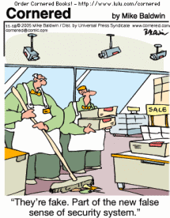
Topics in Security Testing

Slide 2
Computer Security
The goal of computer security is to protect computer assets (e.g., servers, applications, web pages, data) from:
corruption
unauthorized access
denial of authorized access
malicious software
Security is strengthened by:
physically limiting the access of computers to trusted users
hardware mechanisms (e.g., biometrics)
operating system mechanisms that impose rules on untrusted programs (e.g., role-based access control)
anti-virus software to detect malware
secure coding techniques (e.g., array bounds checking) to make code less vulnerable to security attacks.

Slide 3
Approach to Software Security
Verify that security mechanisms are trustworthy
Verify that security architecture adheres to the security policy
Verify that the applications that constitute the system are trustworthy
i.e., they have been developed using secure coding practices, or they are not malware.

Slide 4
Security Architecture
A security architecture is a specification that is used as a guide to enforce security constraints
It specifies where security mechanisms (e.g., encryption, firewalls) need to be positioned in the software architecture
The quality of a security architecture also depends on the security of the applications that constitute the system

Slide 5
Security Architecture
Security architecture describes the position of security mechanisms in the software architecture and comprises:
subsystems
e.g., web servers, application servers, DBMS, directories, web applications, and legacy applications
communication links between the subsystems
e.g., local or remote function calls and protocols (SSL, HTTPS, LDAP)
position of security mechanisms
e.g., authentication and authorization points, encryption methods, audit, logging, monitoring, intrusion detection, registration, backup, recovery
Notes:
LDAP stands for “Lightweight Directory Access Protocol”. It is a simplification of the X.500 Directory Access Protocol (DAP) used to access directory information. ... The simple authentication method has the LDAP client send the username (as a LDAP distinguished name) and password (in clear text) to the LDAP server.

Slide 6
Example of a Security Architecture

Slide 7
Validating Security Architecture
There are many security faults that arise from a poorly designed security architecture, e.g.,
unauthorized access to data and applications
confidential and restricted data flowing as unencrypted text over network connections
Security architecture is validated using a process called threat modeling.
Threat modeling is typically a manual (i.e., not automated) inspection process, similar to code and requirements inspection.

Slide 8
Threat modeling
Threat Modeling is a process for evaluating a software system for security issues.
It is a variation of the code and specification inspections/verification processes discussed earlier in the course.
The goal is for a review team to look for software features that vulnerable from a security perspective.
Threat modeling is not the responsibility of a software tester, although testers may be involved in the security review team.

Slide 9
Threat modeling process (1)
Assemble the treat modeling team
Include security experts and consultants
Identify the assets
E.g., credit card numbers, social security numbers, computing resources, trade secrets, financial data
Create an architecture overview
Define the architecture and identify the trust boundaries and authentication mechanisms
Decompose the application
E.g., identify data flows, encryption processes, password flows.

Slide 10
Threat modeling process (2)
Identify threats
E.g., can data be viewed, changed? Limit access of legitimate users? Unauthorized access of the system?
Document threats
E.g., describe threat, target, form of attack, counter-measures to prevent an attack, etc.
Rank threats (scale: low, medium, high)
Damage potential
E.g., property, data integrity, financial loss
Reproducibility
E.g., probability that an attempt to compromise the system will succeed
Exploitability/Discoverability
E.g., is it difficult to hack into the system?
Affected users
How many users will be affected? Who are these users? Are they important?

Slide 11
What is Malware?
Malware (malicious software) is any program that works against the interest of the system’s user or owner.
Question: Is a program that spies on the web browsing habits of the employees of a company considered malware?
What if the CEO authorized the installation of the spying program?
https://en.wikipedia.org/wiki/Spyware
Notes:
Malware is a blanket term that is used to describe a number of malicious types of software, including adware, spyware, viruses, trojans and more. Spyware is a specific type of malware, but is quite different from most other malicious software because of what it is designed to do.
Viruses, worms, and Trojans are defined by the way they spread. Other malicious programs take their names from what they do. Spyware, not surprisingly, refers to software that spies on your computer and steals your passwords or other personal information. Spyware may also literally spy on you by peeking through your computer's webcam. Many modern antivirus programs include components specifically designed for spyware protection.

Slide 12
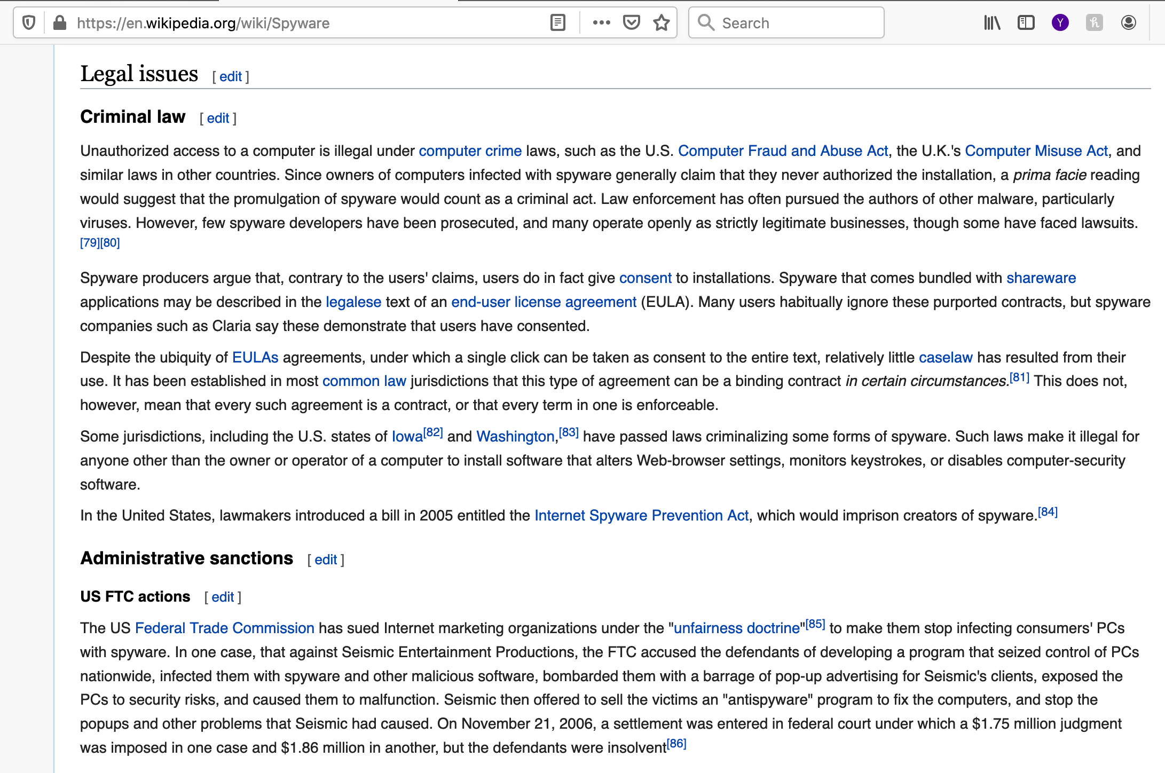

Slide 13
Uses of Malware
Why do people develop and deploy malware?
Financial gain
Psychological urges and childish desires to “beat the system”.
Access private data
…

Slide 14
Typical purposes of Malware
Backdoor access:
Attacker gains unlimited access to the machine.
Denial-of-service (DoS) attacks:
Infect a huge number of machines to try simultaneously to connect to a target server in hope of overwhelming it and making it crash.
Vandalism:
E.g., defacing a web site.
Resource Theft:
E.g., stealing other user’s computing and network resources, such as using your neighbors’ Wireless Network.
Information Theft:
E.g., stealing other user’s credit card numbers.

Slide 15
Types of Malware
Viruses
Worms
Trojan Horses
Backdoors
Mobile code
Adware
Sticky software

Slide 16
Origin of the term computer virus
The term computer virus was first used in an academic publication by Fred Cohen in his 1984 paper Experiments with Computer Viruses.
However, a mid-1970s science fiction novel by David Gerrold, When H.A.R.L.I.E. was One, includes a description of a fictional computer program called VIRUS.
John Brunner's 1975 novel The Shockwave Rider describes programs known as tapeworms which spread through a network for deleting data.
The term computer virus also appears in the comic book Uncanny X-Men in 1982.

Slide 17
The first computer viruses
A program called Elk Cloner is credited with being the first computer virus to appear "in the wild". Written in 1982 by Rich Skrenta, it attached itself to the Apple DOS 3.3 operating system and spread by floppy disk.
The first PC virus was a boot sector virus called (c)Brain, created in 1986 by two brothers, Basit and Amjad Farooq Alvi, operating out of Lahore, Pakistan.

Slide 18
Worms
Worms are malicious programs that use the Internet to spread.
Similar to a virus, a worm self-replicates.
Unlike a virus, a worm does not need human intervention to replicate.
Worms have the ability to spread uncontrollably in a very brief period of time.
Almost every computer system in the world is attached to the same network.

Slide 19
Worms: Operation
A worm may spread because of a software vulnerability exploit:
Takes advantage of the OS or an application program with program vulnerabilities that allow it to hide in a seemingly innocent data packet.
A worm may also spread via e-mail.
Mass mailing worms scan the user’s contact list and mail themselves to every contact on such a list.
In most cases the user must open an attachment to trigger the spreading of the worm (more like a virus).

Slide 20
Trojan horses
A Trojan Horse is a seemingly innocent application that contains malicious code that is hidden somewhere inside it.
Trojans are often useful programs that have unnoticeable, yet harmful, side effects.

Slide 21
Trojan horses: Operation (1)
Embed a malicious element inside an otherwise benign program.
The victim:
receives the infected program,
launches it,
remains oblivious of the fact that the system has been infected.
The application continues to operate normally to eliminate any suspicion.

Slide 22
Trojan horses: Operation (2)
Fool users into believing that a file containing a malicious program is really an innocent file such as a video clip or an image.
This is easy to do on MS Windows because file types are determined by their extension as opposed to examining the file headers.
E.g.,
“A Great Picture.jpg .exe”
The .exe might not be visible in the browser.
The Trojan author can create a picture icon that is the default icon of MS Windows for .jpg files.

Slide 23
Backdoors
A backdoor is malware that creates a covert access channel that the attacker can use for:
connecting,
controlling,
spying,
or otherwise interacting with the victim’s system.

Slide 24
Backdoors: Operation
Backdoors can be embedded in actual programs that, when executed, enable the attacker to connect to and to use the system remotely.
Backdoors may be planted into the source code by rogue software developers before the product is released.
This is more difficult to get away with if the program is open source.

Slide 25
Mobile code
Mobile code is a class of benign programs that are:
meant to be mobile,
meant to be executed on a large number of systems,
not meant to be installed explicitly by end users.
Most mobile code is designed to create a more active web browsing experience.
E.g., Java applets, ActiveX controls.

Slide 26
Mobile code (Cont’d)
Java scripts are distributed in source code form making them easy to analyze.
ActiveX components are conventional executables that contain native IA-32 machine code.
Java applets are in bytecode form, which makes them easy to decompile.

Slide 27
Mobile code: Operation
Web sites quickly download and launch a program on the end user’s system.
User might see a message that warns about a program that is about to be installed and launched.
Most users click OK to allow the program to run.
They may not consider the possibility that malicious code is about to be downloaded and executed on their system.

Slide 28
Adware
Adware is a program that forces unsolicited advertising on end users.
Adware is a new category of malicious programs that has become very popular.
Adware is usually bundled with free software that is funded by the advertisements displayed by the Adware program.

Slide 29
Adware: Operation (1)
The program gathers statistics about the end user’s browsing and shopping habits.
The data might be transferred to a remote server.
Then the Adware uses the information to display targeted advertisements to the end user.

Slide 30
Adware: Operation (2)
Adware can be buggy and can limit the performance of the infected machine.
E.g., MS IE can freeze for a long time because an Adware DLL is poorly implemented and does not use multithreading properly.
Ironically, buggy Adware defeats the purpose of the Adware itself.

Slide 31
Sticky software
Sticky software implements methods that prevent or deter users from uninstalling it manually.
One simple solution is not to offer an uninstall program.
Another solution in Windows involves:
installing registry keys that instruct Windows to always launch the malware as soon as the system is booted.
The malware monitors changes to the registry and replace the keys of they are deleted by the user.
The malware uses two mutually monitoring processes to ensure that the user does not terminate the malware before deleting the keys.

Slide 32
Future Malware
Today’s malware is just the tip of the iceberg.
The next generation of malware may take control of the low levels of the computer system (e.g., BIOS, Firmware).
The antidote software will be in the control of the malware …
Also the theft of valuable information can result in holding it for ransom.

Slide 33
Information-stealing worms
Present-day malware does not take advantage of cryptography much.
Asymmetric encryption creates new possibilities for the creation of information-stealing worms.
A worm encrypts valuable data on the infected system using an asymmetric cipher and hold the data as ransom.

Slide 34
Information-stealing worms:Operation
The Kleptographic worm embeds a public encryption key in its body.
It starts encrypting every bit of valuable data on the host using the public key.
Decryption of the data is impossible without the private key.
Attacker blackmails the victim demanding ransom.
Attacker exchanges the private key for the ransom while maintaining anonymity.
Theoretically possible using zero-knowledge proofs
Attacker proves that he has the private key without exposing it.

Slide 35
BIOS/Firmware Malware
Antivirus programs assume that there is always some trusted layer of the system.
Naïve antivirus programs scan the hard drive for infected files using the high-level file-system service.
A clever virus can intercept file system calls and present to the virus with fake versions (original/uninfected) of the files on disk.
Sophisticated antivirus programs reside at a low enough level (in OS kernel) so that malware cannot distort their view of the system.

Slide 36
BIOS/Firmware Malware: Operations (1)
What is the malware altered an extremely low level layer of the system?
Most CPUs/hardware devices run very low-level code that implements each assembly language instruction using low level instructions (micro-ops).
The micro-ops code that runs inside the processor is called firmware.
Firmware can be updated using a firmware-updating program.

Slide 37
BIOS/Firmware Malware: Operations (2)
Malicious firmware can (in theory) be included in malware that defeats antivirus programs.
The hardware will be compromised by the malicious firmware.
Not easy to do in practice because firmware update files are encrypted (private key inside the processor).

Slide 38
Antivirus programs
Antivirus programs identify malware by looking for unique signatures in the code of each program (i.e., potential virus) on a computer.
A signature is a unique sequence of code found in a part of the malicious program.
The antivirus program maintains a frequently updated database of virus signatures.
The goal is for the database to contain a signature for every known malware program.
Well known antivirus software includes:
Symantec (http://www.symantec.com)
McAfee (http://www.mcafee.com)

Slide 39
Polymorphic viruses
Polymorphism is a technique that thwarts signature-based identification programs.
Polymorphic viruses randomly encode or encrypt the program code in a semantics-preserving way.
The idea is to encrypt the code with a random key and decrypt it at runtime.
Each copy of the code is different because of the use of a random key.
Notes:
Polymorphic techniques involve frequently changing identifiable characteristics like file names and types or encryption keys to make the malware unrecognizable to many detection techniques.

Slide 40
Polymorphic viruses: Decryption technique
A decryption technique that polymorphic viruses employ involves “XORing” each byte with a randomized key that was saved by the parent virus.
The use of XOR-operations has the additional advantage that the encryption and decryption routine are the same:
a xor b = c
c xor b = a

Slide 41
Polymorphic viruses: Weaknesses
Many antivirus programs scan for virus signatures in memory.
I.e., after the polymorphic virus has been decrypted.
If the virus code that does the decryption is static, then the decryption code can be used as a signature.
This limitation can be addressed (somewhat) if the decryption code is scrambled (superficially):
randomize the use of registers,
add no-ops in the code, …

Slide 42
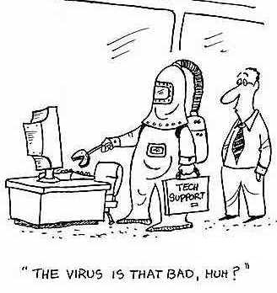
Metamorphic viruses
Instead of encrypting the program’s body and making slight alterations in the decryption engine, alter the entire program each time it is replicated.
This makes it extremely difficult for antivirus writers to use signature-matching techniques to identify malware.
Metamorphism requires a powerful code analysis engine that needs to be embedded into the malware.

Slide 43
Metamorphic viruses: Operation
Metamorphic engine scans the code and generates a different version of it every time the program is duplicated.
The metamorphic engine performs a wide variety of transformations on the malware and on the engine itself.
Instruction and register randomization.
Instruction ordering
Reversing (negating) conditions
Insertion of “garbage” instructions
Reordering of the storage location of functions

Slide 44
Timeline of famous malware (1982-1988) [wikipedia]
1982
Elk Cloner, written for Apple II systems, is credited with being the first computer virus.
1987
(c)Brain, the first virus written for PCs.
SCA, a boot sector virus for Amiga appears, immediately creating a pandemic virus-writer storm. A short time later, SCA releases another, considerably more destructive virus, the Byte Bandit.
1988
Morris worm infects DEC VAX machines connected to the Internet and becomes the first worm to spread extensively.

Slide 45
Timeline of famous malware (1998-2000) [wikipedia]
1998
CIH virus version 1.
1999
Melissa worm is released, targeting Microsoft Word and Outlook-based systems, and creating considerable network traffic.
2000
The VBS/Loveletter worm, also known as the "I love you" virus appeared. As of 2004, this was the most costly virus to business, causing upwards of 10 billion dollars in damage.

Slide 46
Timeline of famous malware (2001) [wikipedia]
Klez worm.
Nimda worm.
Code Red II worm (spreads in China, attacks Microsoft's Internet Information Services.
Sircam worm (spreads through e-mails and unprotected network shares).
Sadmind worm (spreads by exploiting holes in both Sun Microsystem's Solaris and MS IIS).
Raman worm (similar to the Morris worm infected only Red Hat Linux machines running version 6.2 and 7.0, using three vulnerabilities in wu-ftpd,rpc-statd and lpd.

Slide 47
Timeline of famous malware (2003) [wikipedia]
Sober worm is first seen and maintains its presence until 2005 with many new variants.
Sobig worm (technically the Sobig.F worm) spread rapidly via mail and network shares.
Blaster worm also know as the Lovesan worm spread rapidly by exploiting MS computers.
SQL slammer worm also known as the Sapphire worm, attacked vulnerabilities in Microsoft SQL Server and MSDE, causes widespread problems on the Internet.

Slide 48
Timeline of famous malware (2004) [wikipedia]
Sasser worm emerges by exploiting a vulnerability in LSASS, causes problems in networks.
Witty worm is a record breaking worm in many regards.
It exploited holes in several Internet Security Systems (ISS) products.
it was the first internet worm to carry a destructive payload and it spread rapidly using a pre-populated list of ground-zero hosts.
MyDoom emerges, and currently holds the record for the fastest-spreading mass mailer worm.

Slide 49
Timeline of famous malware (2005) [wikipedia]
Zotob worm, the effect was overblown because several United States media outlets were infected.

Slide 50
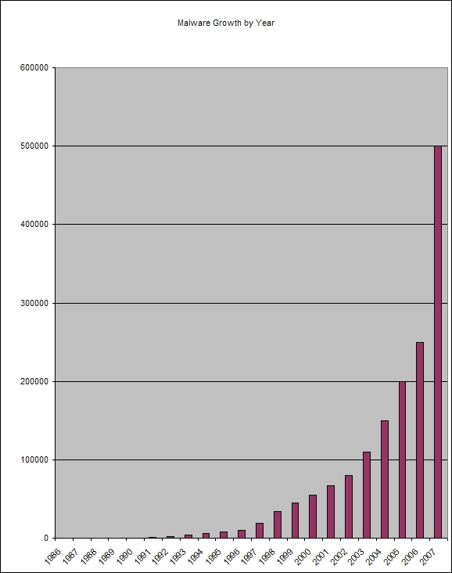
Malware Growth by Year

Slide 51
Security auditing problems
Large scale auditing infeasible due code size
Good source code will have 1-3 bugs for every 100 lines of code
Security auditors need to find the software security vulnerabilities in the bugs
Security audits would benefit from a tool that identify areas that are likely vulnerable
Notes:
Due to the code size of large scale systems, auditing is infeasible. Therefore auditors must use their expertise to find areas which could pose a problem. If the system is poorly documented, has been maintained poorly, or gone through a period of rapid feature development auditing becomes a problem of reverse engineering.
Bezier states that for every hundred lines of code in good code there will be 1 to 3 bugs. If the bugs do not violate an explicit or implicit security policy it is not a security vulnerability and therefore of no concern to a security auditor.
Locating security vulnerabilities is a task that requires a lot of manual code browsing and flow tracing.
Security audits would benefit financially, temporally, and rigorously from a tool which locates those areas of code which have been shown to be statistically more vulnerable.

Slide 52
Improving the security audit
Cut down the amount of code needed to be reviewed
Ensure high degree of accuracy
Bottom line: Complexity reduction
Notes:
Managers, why are we here? To address the problem of security vulnerabilities in code.
This problem is going to be addressed with the tools based on sound research.
Reduce the complexity (and thus the time and expense) of security auditing
Manager/Director this research and tools are aimed at improving software security by reducing the complexity of a software audit

Slide 53
Research Challenges
Formal Security Architectures
“The software maintenance community is challenged to investigate the creation of a suite of tools to model and simulate the behavior of security architectures as well as support the verification of properties that are relevant to security”
Security Attack Diagnosis and Mitigation
“The software maintenance community is challenged to investigate techniques that will enable software to self-diagnose security attacks and self-mitigate the effects of these attacks at run-time”

Slide 54
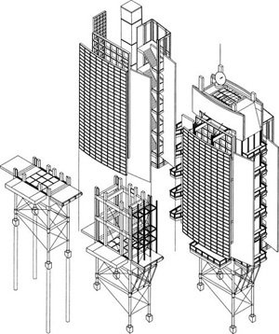
Formal Security Architectures
The security architectures of industrial-strength software systems are specified using natural language and informal diagrams
These security architectures are validated using manual inspection processes
A barrier to the automation of the analysis of security architectures is the absence of formalism in the notations used in practice to describe security architectures.

Slide 55
Formal Security Architectures
Future notations and tools to support security architecture may involve:
Formal modeling notations to specify security architecture
Tools to simulate the execution behavior of software security models
Model checking tools to verify properties of security architecture

Slide 56
Security Attack Diagnosis & Mitigation
Servers and applications developed using secure coding may still not respond adequately to security attacks at run time
The capacity of a server to diagnose security attacks automatically before it is exploited is important
especially if the server is used in a safety-critical domain
Self-mitigation strategies are also needed to enable software to continue functioning
especially if applications and servers are deployed in contexts where patching and re-starting the software is not a practical option

Slide 57
Toward Security Attack Diagnosis & Mitigation
Develop software sensors that monitor various aspects of the execution behavior of software
Create formal self-diagnostic models based on deviations from a software’s expected behavior
Automatically disable software features and enable security mechanisms at run time in response to diagnosed security attacks
Evolve the diagnostic and mitigation capabilities of software over time by learning from their past experiences

