Slide 1
Topics in Metrics for Software Testing

Slide 2
Quantification
One of the characteristics of a maturing discipline is the replacement of art by science.
Early physics was dominated by philosophical discussions with no attempt to quantify things.
Quantification was impossible until the right questions were asked.

Slide 3
Quantification (Cont’d)
Computer Science is slowly following the quantification path.
There is skepticism because so much of what we want to quantify it tied to erratic human behavior.

Slide 4
Software quantification
Software Engineers are still counting lines of code.
This popular metric is highly inaccurate when used to predict:
costs
resources
schedules

Slide 5
Science begins with quantification
Physics needs measurements for time, mass, etc.
Thermodynamics needs measurements for temperature.
The “size” of software is not obvious.
We need an objective measure of software size.

Slide 6
Software quantification
Lines of Code (LOC) is not a good measure software size.
In software testing we need a notion of size when comparing two testing strategies.
The number of tests should be normalized to software size, for example:
Strategy A needs 1.4 tests/unit size.

Slide 7
Asking the right questions
When can we stop testing?
How many bugs can we expect?
Which testing technique is more effective?
Are we testing hard or smart?
Do we have a strong program or a weak test suite?
Currently, we are unable to answer these questions satisfactorily.

Slide 8
Lessons from physics
Measurements lead to Empirical Laws which lead to Physical Laws.
E.g., Kepler’s measurements of planetary movement lead to Newton’s Laws which lead to Modern Laws of physics.

Slide 9
Lessons from physics (Cont’d)
The metrics we are about to discuss aim at getting empirical laws that relate program size to:
expected number of bugs
expected number of tests required to find bugs
testing technique effectiveness

Slide 10
Metrics taxonomy
Linguistic Metrics: Based on measuring properties of program text without interpreting what the text means.
E.g., LOC.
Structural Metrics: Based on structural relations between the objects in a program.
E.g., number of nodes and links in a control flowgraph.

Slide 11
Lines of code (LOC)
LOC is used as a measure of software complexity.
This metric is just as good as source listing weight if we assume consistency w.r.t. paper and font size.
Makes as much sense (or nonsense) to say:
“This is a 2 pound program”
as it is to say:
“This is a 100,000 line program.”

Slide 12
Lines of code paradox
Paradox: If you unroll a loop, you reduce the complexity of your software ...
Studies show that there is a linear relationship between LOC and error rates for small programs (i.e., LOC < 100).
The relationship becomes non-linear as programs increases in size.

Slide 13
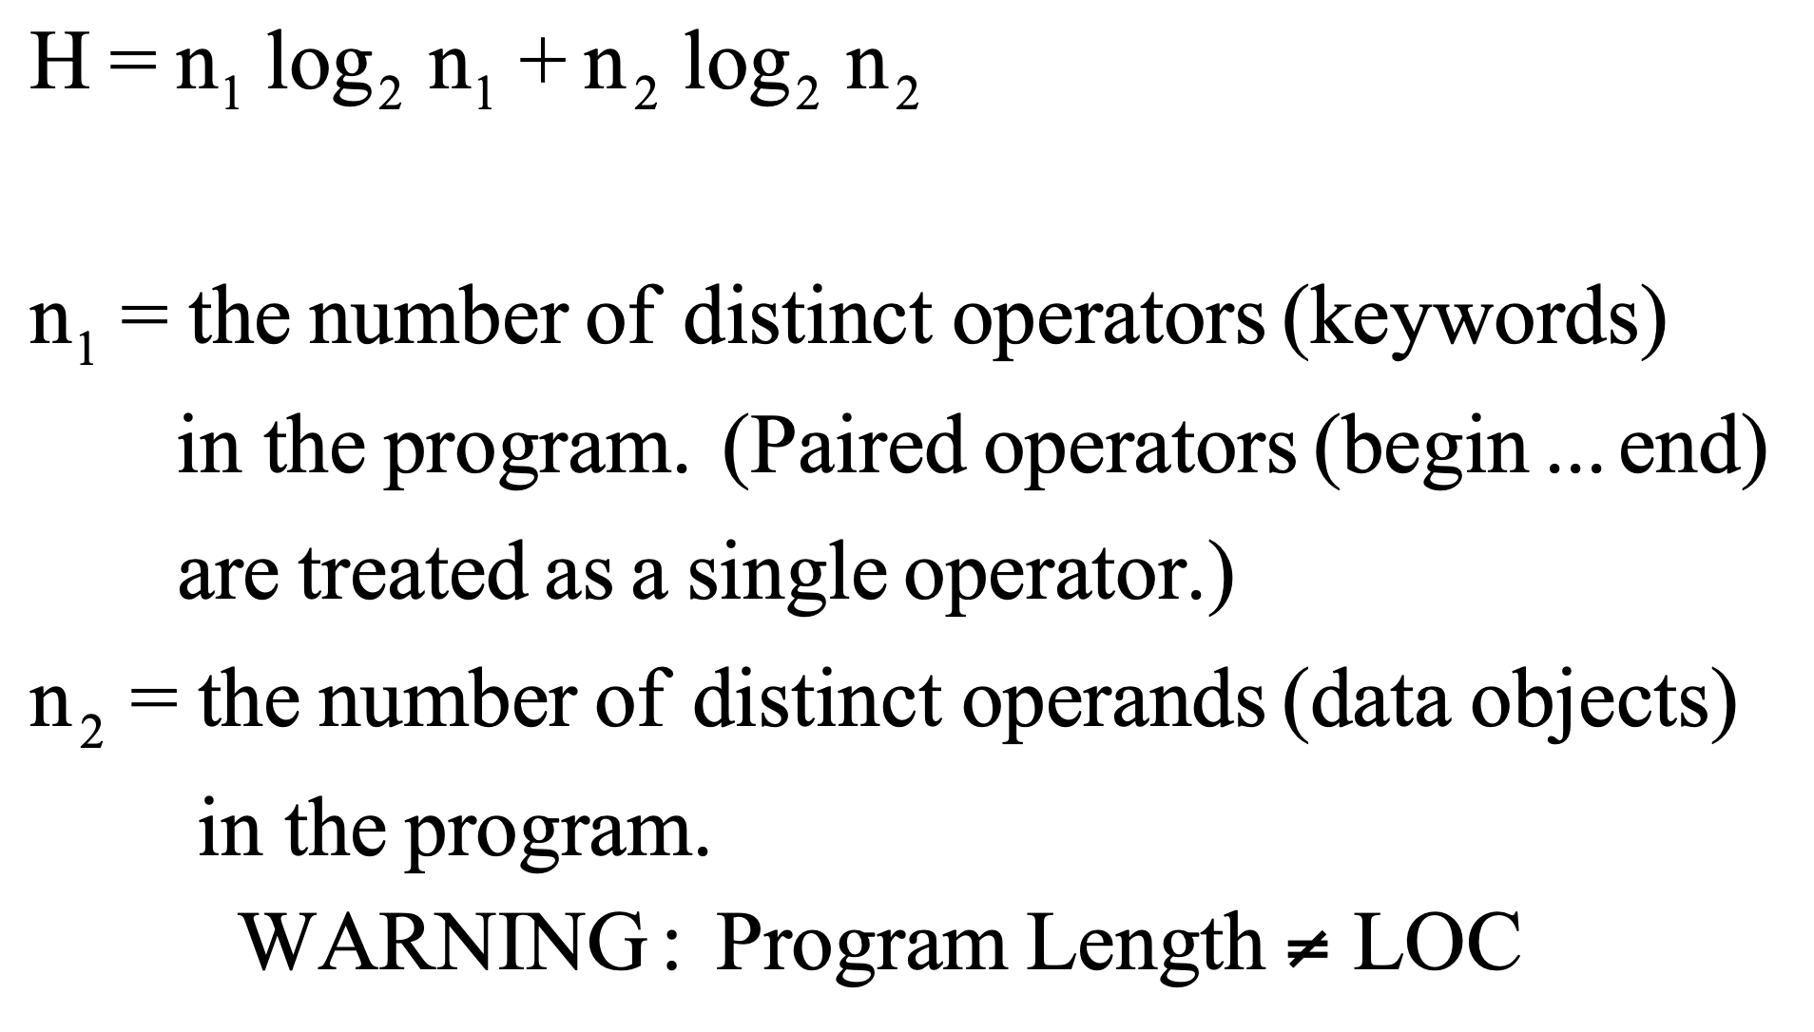
Halstead’s program length

Slide 14
Example of program length
if (y < 0)
pow = - y;
else
pow = y;
z = 1.0;
while (pow != 0) {
z = z * x;
pow = pow - 1;
}
if (y < 0)
z = 1.0 / z;
n
=
9
(if,
<,
=,-
(sign),
while,
1
!
=,
*,
-
(minus),
/)
n
=
7
(y,
0,
pow,
z,
x,
1,
1.0)
2
H
=
9
log
9
+
7
log
7
≈
48
2
2

Slide 15
Example of program length
for ( j=1; j<N; j++) {
last = N - j + 1;
for (k=1; k <last; k ++) {
if (list[k] > list[k+1]) {
temp = list[k];
list[k] = list[k+1];
list[k+1] = temp;
}
}
}
n
=
9
(for,
=,
<,
+
+,
-,
+,
[],
>,
if)
1
n
=
7
(j,
1,
N,
last,
k,
list,
temp)
2
H
=
9
log
9
+
7
log
7
≈
48
2
2

Slide 16
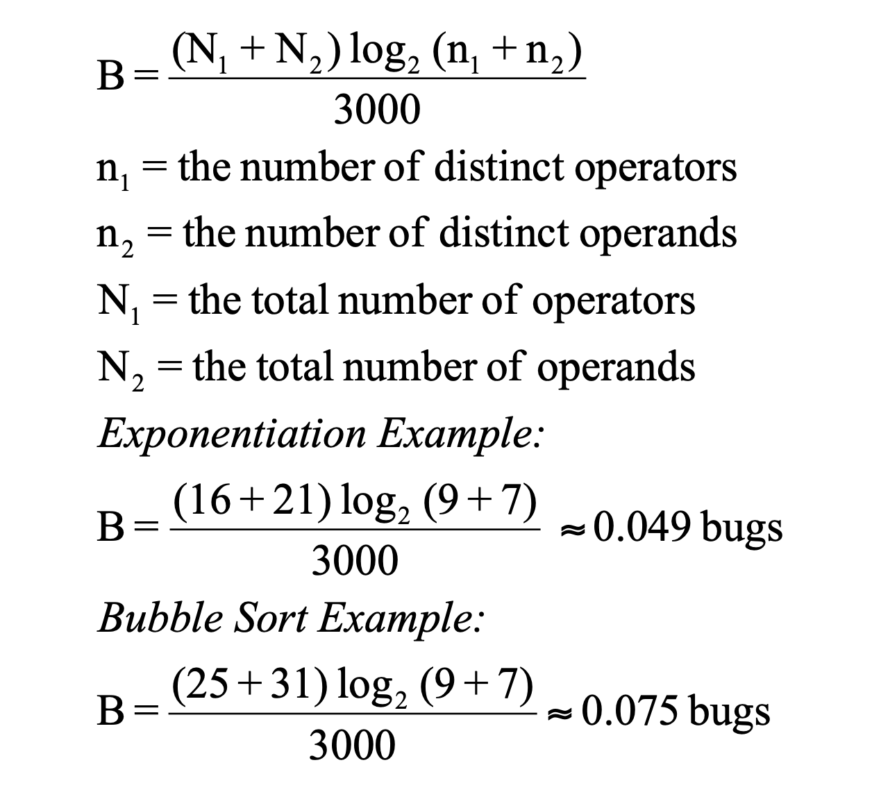
Halstead’s bug prediction

Slide 17
How good are Halstead’s metrics?
The validity of the metric has been confirmed experimentally many times, independently, over a wide range of programs and languages.
Lipow compared actual to predicted bug counts to within 8% over a range of program sizes from 300 to 12,000 statements.

Slide 18
Structural metrics
Linguistic complexity is ignored.
Attention is focused on control-flow and data-flow complexity.
Structural metrics are based on the properties of flowgraph models of programs.

Slide 19
Cyclomatic complexity
McCabe’s Cyclomatic complexity is defined as: M = L - N + 1
L = number of links in the flowgraph
N = number of nodes in the flowgraph

Slide 20
Property of McCabe’s metric
The complexity of several graphs considered together is equal to the sum of the individual complexities of those graphs.

Slide 21
Cyclomatic complexity heuristics
To compute Cyclomatic complexity of a flowgraph with a single entry and a single exit:
Note:
Count n-way case statements as N binary decisions.
Count looping as a single binary decision.

Slide 22
Applying cyclomatic complexity to evaluate test plan completeness
Count how many test cases are intended to provide branch coverage.
If the number of test cases < M then one of the following may be true:
You haven’t calculated M correctly.
Coverage isn’t complete.
Coverage is complete but it can be done with more but simpler paths.
It might be possible to simplify the routine.

Slide 23
Warning
Use the relationship between M and the number of covering test cases as a guideline not an immutable fact.

Slide 24
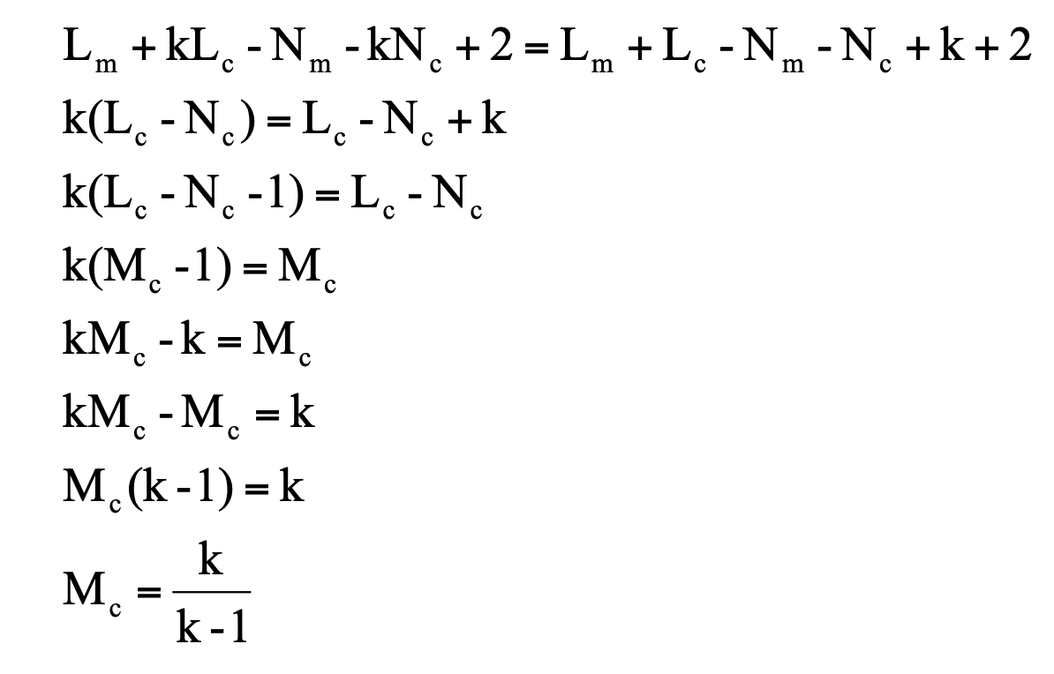
When is the creation of a subroutine cost effective?
Break Even Point occurs when the total complexities are equal:
The break even point is independent of the main routine’s complexity.

Slide 25
Example
If the typical number of calls to a subroutine is 1.1 (k=1.1), the subroutine being called must have a complexity of 11 or greater if the net complexity of the program is to be reduced.

Slide 26
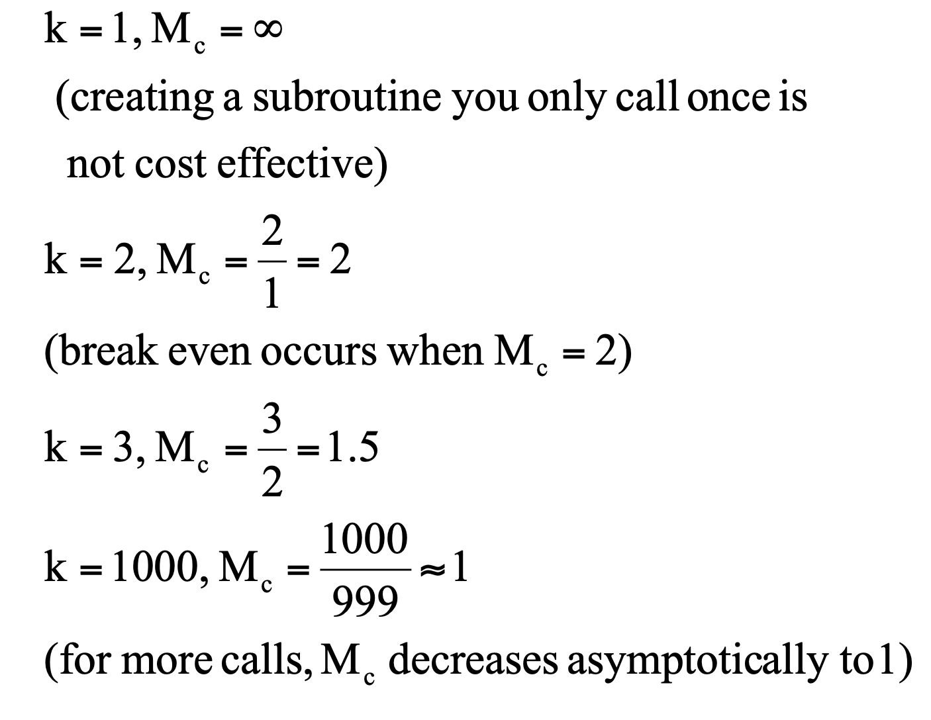
Cost effective subroutines (Cont’d)

Slide 27
Cost effective subroutines (Cont’d)

Slide 28
Relationship plotted as a function
Mc
1
0
1
k
Note that the function does not make sense for values of 0 < k < 1 because Mc < 0!
Therefore we need to mention that k > 1.

Slide 29
How good is M?
A military software project applied the metric and found that routines with M > 10 (23% of all routines) accounted for 53% of the bugs.
Also, of 276 routines, the ones with M > 10 had 21% more errors per LOC than those with M <= 10.
McCabe advises partitioning routines with M > 10.

Slide 30
Pitfalls
if ... then ... else has the same M as a loop!
case statements, which are highly regular structures, have a high M.
Warning: McCabe’s metric should be used as a rule of thumb at best.

Slide 31
Rules of thumb based on M
Bugs/LOC increases discontinuously for
M > 10
M is better than LOC in judging life-cycle efforts.
Routines with a high M (say > 40) should be scrutinized.
M establishes a useful lower-bound rule of thumb for the number of test cases required to achieve branch coverage.

Slide 32
Software testing process metrics
Bug tracking tools enable the extraction of several useful metrics about the software and the testing process.
Test managers can see if any trends in the data show areas that:
may need more testing
are on track for its scheduled release date
Examples of software testing process metrics:
Average number of bugs per tester per day
Number of bugs found per module
The ratio of Severity 1 bugs to Severity 4 bugs
…

Slide 33
Example queries applied to a bug tracking database
What areas of the software have the most bugs? The fewest bugs?
How many resolved bugs are currently assigned to John?
Mary is leaving for vacation soon. How many bugs does she have to fix before she leaves?
Which tester has found the most bugs?
What are the open Priority 1 bugs?

Slide 34
Example data plots
Number of bugs versus:
fixed bugs
deferred bugs
duplicate bugs
non-bugs
Number of bugs versus each major functional area of the software:
GUI
documentation
floating-point arithmetic
etc

Slide 35
Example data plots (cont’d)
Bugs opened versus date opened over time:
This view can show:
bugs opened each day
cumulative opened bugs
On the same plot we can plot resolved bugs, closed bugs, etc to compare the trends.

Slide 36
You now know …
… the importance of quantification
… various software metrics
… various software testing process metrics and views

