Slide 1
Informal Verification
Design Diagrams

Slide 2
A Car Rental System
A car rental company has several different types of vehicles (cars, trucks, SUVs etc.). The rate for a vehicle varies with respect to its type as shown in Table 1. The actual rental charge includes the rate multiplied by the number of days it is rented, plus additional charges for the miles the vehicle is driven, if applicable. A customer who wants to rent a car may ask for a specific type of vehicle or may choose one of the available vehicles.

Slide 3
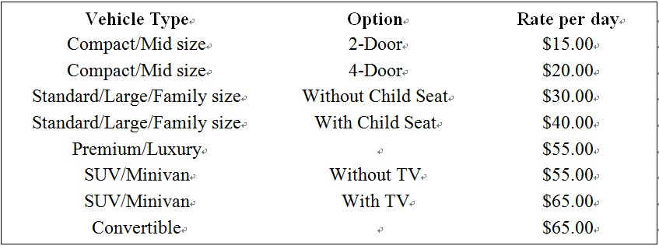
A Car Rental System (Continued)
Following is the rental charges for different types of vehicles in the company.

Slide 4
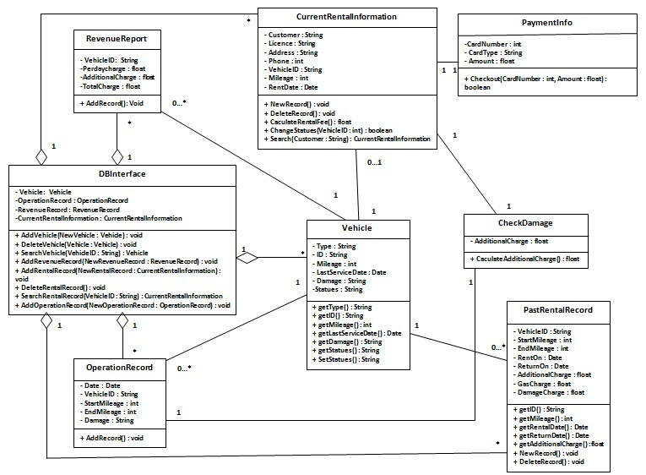
Class Diagram for the Car Rental System

Slide 5
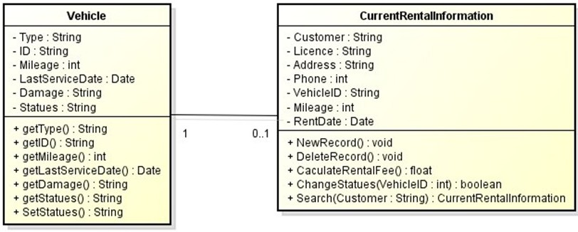
The link between classes Vehicle and CurrentRentalInformation

Slide 6
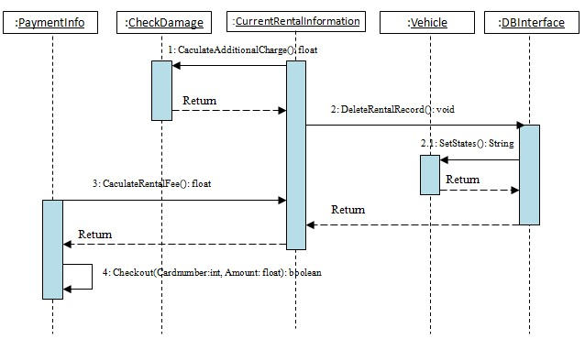
Sequence Diagram for “Return a Vehicle”

