Slide 1
Classes and their relationships

Slide 2
OO Design
Identify a first set of candidate classes
Add associations and attributes
Find generalizations
List the main responsibilities of each class
Decide on specific operations
Iterate over the entire process until the model is satisfactory
Add or delete classes, associations, attributes, generalizations, responsibilities or operations
Identify interfaces
Apply design patterns
Don’t be too disorganized. Don’t be too rigid either.

Slide 3
How to find classes?
Nouns in requirements document or use case descriptions may provide a good starting point, but often are inadequate
Each class should contain a distinct set of operations relevant to the system under consideration
Think of a class as an ADT
Remove vague classes
Classes that do not adequately describe themselves
A class that represents the internet

Slide 4
How to find classes (continued)
Try not to include implementation-oriented classes in the analysis model
May be introduced later during design and/or implementation
Examples: array, tree, list
These classes will not only occupy so much space in the diagram but also tend to divert the focus of analysis

Slide 5
How to identify associations?
An association corresponds to a semantic dependency between classes
Class A uses a service from class B (client-server)
Class A has a structural component whose type is class B (aggregation)
Class A sends data to or receives data from class B (communication)

Slide 6
How to identify associations (continued)
Include only those associations that are relevant to the current model
Constrained by assumptions, simplifications, system boundary (what is expected to be provided by the system)
Three different associations between “Faculty member” and “Course”
“Faculty member” teaches “Course” in a course registration system
“Faculty member” creates “Course” in a curriculum development system
“Faculty member” evaluates “Course” in a course evaluation/inspection system

Slide 7
How to identify associations (continued)
Eliminate redundant associations
“Faculty member” teaches “Course”
“Course” is taught between “Time” to “Time”
Therefore, “Faculty member” teaches between “Time” to “Time”
use transitivity between associations
Remember that subclasses inherit the associations of a superclass

Slide 8
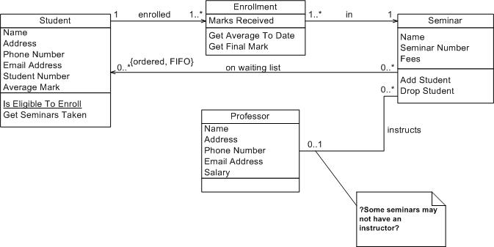
Example

Slide 9
How to identify aggregations?
Aggregations are also associations
Identify as Association if it is not clear whether it is Association or Aggregation
“Mail” has “Address” (aggregation)
“Mail” uses “Address” for delivery (association)
“Customer” has “Address” (aggregation)
“Customer” resides at “Address” (association)
“TV” includes “Screen” (aggregation)
“TV” sends information to “Screen” (association)

Slide 10
How to identify specialization?
Generally, specialization relationships are noticeable in the application domain
Top-down approach
“Student”, “Full-time Student”, “Part-time Student”
“TV”, “Plasma TV”, “Flat Panel TV”
“Customer”, “Bank manager”, “Teller”

Slide 11
How to identify specialization (continued)
Some of them are discovered during analysis
Bottom-up approach
“Part-time Instructor” derived from “Instructor” and “Student” while modeling a department
“User” derived from “Customer”, “Bank Manager” and “Teller” while modeling an ATM system
“Material” derived from “Book”, “Journal” and “Magazine” while modeling a library catalog system

Slide 12
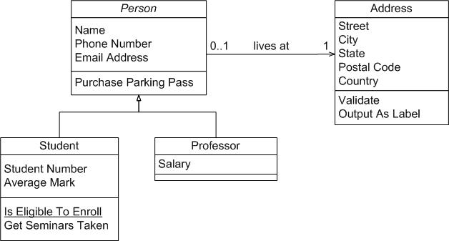
Example

Slide 13
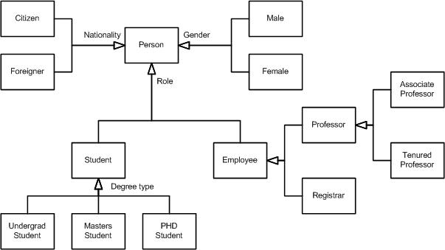
Example

Slide 14
Deriving components of a class diagram from a use case diagram
Actors are potential candidates for classes
Sometimes, an actor may not be modeled as a class
Specialization between actors will end up in specialization relationship between the corresponding classes

Slide 15
Deriving components of a class diagram from a use case diagram
Two actors may be related to each other if they are connected through a series of use cases
The classes corresponding to these actors will thus have an association
See the ATM example – the actor “User” is related to “Account” because of the use cases “deposit” and “update account”
The relationship among use cases will be exploited later in dynamic modeling

