Slide 1
Use Case Model

Slide 2
Use case model
Describes what a user expects the system to do
functional requirements
May describe only the functionalities that are visible to the user
requirements view
May include additional functionalities to elaborate those in the previous step
design view
Consists of use case diagrams and textual descriptions

Slide 3
Elements of a Use Case diagram
Subject
dependency
Use case
Use case
association
generalization
association
Use case
Use case
actor
dependency
actor

Slide 4
Definitions
Subject
A black box that describes the system or subsystem that is modeled
Example: ATM system, login subsystem
Represented optionally as a rectangle in the use case diagram, but generally not shown
Actor
A role played by an external entity that interacts with the subject
One object may play multiple roles in a context in which case there will be multiple actors
example: bank manager playing the role of a teller or that of a customer

Slide 5
Definitions (continued)
Primary actor
An actor who initiates the major, main or important use cases in the system
Example : a customer in a banking system
Secondary actor
An actor who is involved with one or more use cases but does not initiate any use case
Example : database
There is no syntactic difference between a primary actor and a secondary actor

Slide 6
Definitions (continued)
Generalization between actors
One actor can be a specialization of another actor
Based on the same concept as the specialization relationship between classes
Example : preferred customer in a bank is a specialization of a customer
Use case
An important functionality to be implemented and is visible to the actors
An interacting behavior between an actor and the subject
Must yield an observable result to the actor
Example: “deposit” in a banking system

Slide 7
Definitions (continued)
Association
An interaction between an actor and a use case
Unidirectional associations must be represented by arrows
Direction of arrow indicates information flow
Bi-directional associations can be represented by double-sided arrows or straight lines

Slide 8
Definitions (continued)
“include” dependency
One use case may include another use case
If use case A includes use case B, B must be implemented in order to implement A
Represented as a dashed arrow from A to B with a label “<<include>>”
Example : use case “withdraw” includes use case “update account”
<<include>>
A
B

Slide 9
Definitions (continued)
“extend” dependency
One use case may be extended by another use case
If use case A is extended by use case B, then both A and B can be independently implemented and used
A will occasionally use B depending on some constraints

Slide 10
Definitions (continued)
“extend” dependency (continued)
Represented as a dashed arrow from B to A with a label “<<extend>>”
Notice that the arrow is reversed
Example :
Use case “withdraw” is extended by use case “compute penalty” when the user withdraws an amount more than the balance in the account; the use case “compute penalty” is therefore occasionally used by “withdraw”.
<<extend>>
A
B

Slide 11
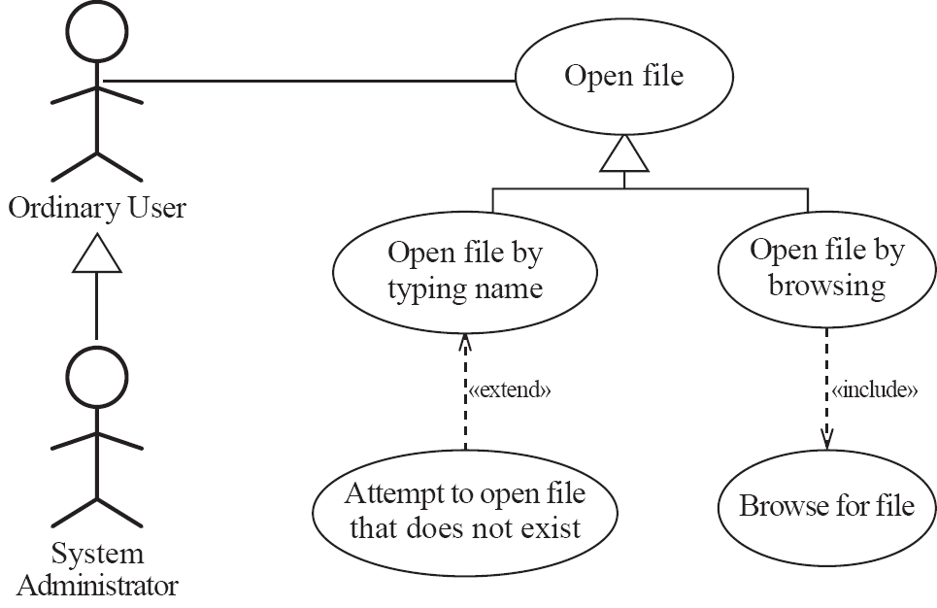
Example of generalization, extension and inclusion

Slide 12
Constraints in a Use Case Model
Every use case must be connected to an actor or be included in another use case or extends another use case
Every use case connected to an actor must return an observable result to the actor
The result may be data, confirmation or termination of an action
Not visible in the diagram but explained in use case narratives
Association is used only between an actor and a use case

Slide 13
Constraints in a Use Case Model
Every actor has a unique name in the diagram. If the diagram includes more than one actor with the same name, they are logically combined into one actor. They might have been represented more than once for simplifying the drawing of the diagram.
Every use case must have a unique name in the diagram. If there is more than one use case with the same name in the diagram, then they are logically combined into one.

Slide 14
Constraints in a Use Case Model
Between two use cases, there can be at most only one relationship
Every actor must have at least one association (a connection to a use case) in the diagram.
Every actor must have at most one association with a particular use case

Slide 15
How to find actors?
Those that interact with the system (provide input, observe results, provide control information, …)
primary actors
Those that are used by the system but external to the system
secondary actors such as database, files, …
Generally, users of the system are primary actors

Slide 16
How to find use cases?
Every requirement is a use case
Every functionality that supports the implementation of a requirement is a use case
Design issue
Found when the first (abstract) use case model is refined to express a design
Do not confuse a “use case” with a “method” in implementation
Generally, there is a one-to-many relationship between a use case and a method

Slide 17
How to find use case relationships?
Extracted from the application domain
Must be justifiable from the application domain or from the designer’s choice
Examples
Use case “withdraw” includes use case “update account” is justifiable from application domain
Use case “withdraw” is extended by “compute penalty” is a designer’s choice
Designer can decide to implement two different versions of withdrawals or just only one with no extension

