Slide 1
Integration Testing

Slide 2
Waterfall model and Testing stages
Requirements
Specification
System
Testing
Preliminary Design
Integration
Testing
Detailed Design
Unit
Testing
Coding
© Paul Jorgensen, 2008

Slide 3
Detailed Design
Requirements
Specification
Coding
Preliminary
Design
Unit Testing
Integration
Testing
Prototyping
Cycles
Regression
Testing
Progression
Testing
Prototyping Model and Integration Testing
© Paul Jorgensen, 2008

Slide 4
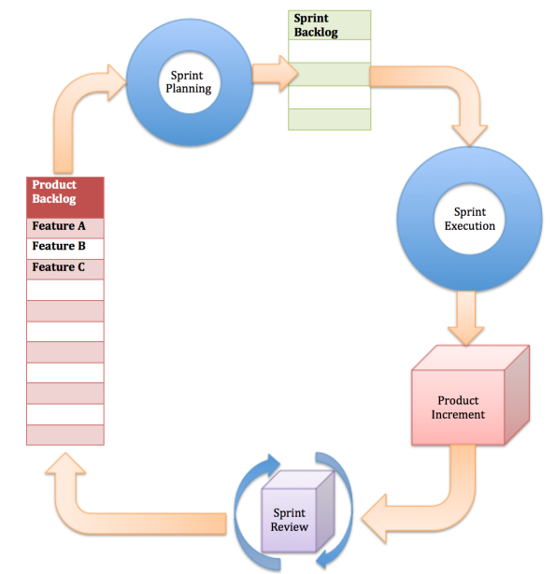
Agile software life cycle © Anoop Shetty, Oct 2011

Slide 5
Time box 1
Time box 2
Time box 3
Time box 4
Time box 5
Time box 6
Iteration 1
Requirements
Design
Implementation
Testing
Solution Increment 1
Iteration 2
Requirements
Design
Implementation
Testing
Solution Increment 2
Iteration 3
Requirements
Design
Implementation
Testing
Solution Increment 3
Another view of agile software life cycle with time boxes
© Greg Hodgkinson, 2009

Slide 6
What is integration testing?
Testing the interfaces among modules
Modules are roughly equated to classes in object-oriented paradigm
Interfaces between modules are defined by the system’s architecture
Modular decomposition / composition of a system
Integration testing assumes that unit testing is done already and all units are working correctly

Slide 7
Two important properties of integration testing
Regression Testing
Ensure that things that were working correctly in the previous cycle still work correctly when new things are added
Progression Testing
Regression testing is successful and the new things work correctly

Slide 8
A note from Paul Jorgensen’s book
In Sep 1999, the Mars Climate Orbiter mission failed after traveling for 41 weeks. It disappeared just it was to begin orbiting Mars. The fault should have been revealed by integration testing: Lockheed Martin used acceleration data in English units (pounds) while Jet Propulsion Lab used metric units (newtons) in its calculations.

Slide 9
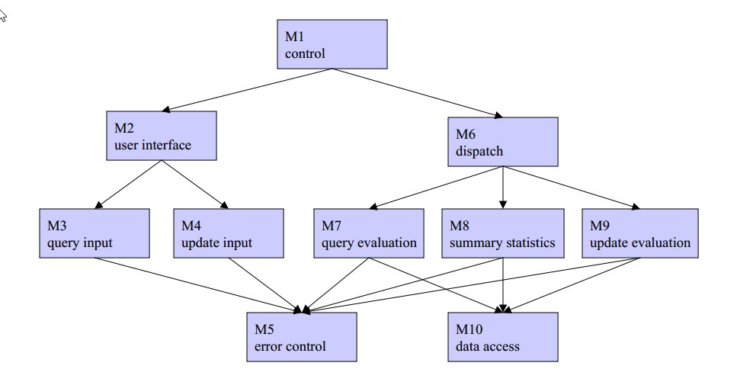
Example : A simple query system
© Grant Weddell, U of Waterloo, 2007

Slide 10
Questions?
Assuming that a group of programmers are working on each module (M1 .. M10 in the previous slide)
Which integration(s) should be done first, which one(s) should be done next and so on?
Which order would be preferable?

Slide 11
Methods for integration testing
Top down integration
Requires “stubs”
Bottom up integration
Requires “drivers”
Call graph-based integration
Requires knowledge of code

Slide 12
Top down integration
Main program
Stub for Component 1
Stub for Component 2
Test “Main program” focusing on the interfaces

Slide 13
What does a “stub” contain?
A stub should contain all information for interfacing
Signature of all methods in the module
Some additional code in each method such as print / display statements to confirm that it works
Creating a stub requires additional efforts

Slide 14
Stubs - example
public static void main (String[] args) {
int[] arr = new int[20];
read (arr);
sort (arr);
if (search (arr, 23)) System.out.println (“ 23 is present in the array”);
else (“23 is not present in the array “);
}
public void read (int[] array) {
System.out.println (“ array reading – will be implemented later “) // STUB
}
public void sort (int[] array) {
System.out.println (“ sorting will be implemented later ”); // STUB
}
public boolean search (int[] array, int k) {
return true; // STUB
}

Slide 15
Bottom-up integration
Driver to test component A
Component A

Slide 16
Bottom-up integration (continued)
Driver to test component B
Component A
Component B

Slide 17
Bottom-up integration (continued)
Driver to test component C
Component C
Component A
Component B

Slide 18
What is a “driver”?
A “driver” program contains the code to call another module / method and pass appropriate parameters
Purpose is to test the other module / method
Similar to a “stub” but the goal and actions are opposite to that of a “stub”
When drivers are replaced by actual code, once again the integration must be tested
➔ additional testing efforts (cost and time)

Slide 19
Common problems with top down and bottom up integrations
Additional “throw-away” code with regard to “stub” or “driver”
Both approaches strictly rely on structural decomposition of the system

Slide 20
Call graph-based integration
Objective
To reduce testing efforts
No “stubs” or “drivers” – test only the actual code
Make use of structural and behavioral composition / decomposition
Information regarding behavioral composition / decomposition may be derived from requirements document and also from detailed design

Slide 21
What is a call graph?
The nodes of a call graph represent units / methods / modules
The edges of a call graph represent the calling sequence / interaction between units / methods / modules
A call graph is different from structural decomposition used in top down and bottom up integration
In the latter, the decomposition strategy is not obvious from the diagram

Slide 22
1
ATM Interface
3
Deposit
4
2
Withdraw
Validate card
5
Check balance
6
Database operations
Call graph for ATM example

Slide 23
1
Main Module interacting with user
3
Read Module
4
2
Write Module
Validate Inputs
5
Compute Module
6
7
Error Module
Database operations
Call graph - another example

Slide 24
Pair-wise integration
Identify the caller-called pairs of units / methods / modules
Integrate and test each pair independently

Slide 25
Pair-wise Integration – ATM Example
Pairs | Batch 1 | Batc 2 | Batch 3 | Batch 4
(1,2) | X
(1,3) |  | X
(1,4) |  |  | X
(1,5) |  |  |  | X
(2,6) |  | X
(3,6) | X
(4,6) |  |  |  | X
(5,6) |  |  | X

Slide 26
Pairwise integration for the other example
Pair | Batch 1 | Batch 2 | Batch 3 | Batch 4 | Batch 5 | Batch 6
(1,7) | X
(2,7) |  | X
(3,7) |  |  | X
(4,7) |  |  |  | X
(5,7) |  |  |  |  | X
(6,7) |  |  |  |  |  | X
(3,2) | X
(3,6) |  | X
(4,6) | X
(5,6) |  |  | X
(1,3) |  |  |  | X
(1,4) |  |  | X
(1,5) |  | X

Slide 27
Advantages of Pair-wise integration
Exploits the actual code for integration and hence no need for stubs or drivers
Only one integration per pair
Remember that in top-down and bottom-up integration, the process must be repeated when the stub/driver is replaced by the actual code
Several pairs can be integrated at the same time if there are no dependencies between them
Faster integration testing

Slide 28
Neighborhood integration
For each node
Identify the neighbors – predecessors and successors in the directed call graph
The nodes that precede this node (who call this node)
The nodes that succeed this node (who are all called from this node)
Integrate all neighbors at once and test each integration separately
Some sort of extended pair-wise integration method

Slide 29
Neighborhood Integration for ATM example
Predecessors | Node | Successors
 | 1 | 2,3,4,5
1 | 2 | 6
1 | 3 | 6
1 | 4 | 6
1 | 5 | 6
2,3,4,5 | 6

Slide 30
Neighborhood Integration for the other example
Predecessors | Node | Successors
 | 1 | 3,4,5,7
3 | 2 | 7
1 | 3 | 2,6,7
1 | 4 | 6,7
1 | 5 | 6,7
3,4,5 | 6 | 7
1,2,3,4,5,6 | 7

Slide 31
Problems with neighborhood integration
Debugging is harder
Identifying the cause and location of a fault is tedious, especially when a fault occurs in a node that appears in several neighborhoods
As the number of nodes in the neighborhood increases, the complexity of debugging increases

Slide 32
Exercise
Develop the Pairwise integration table and neighborhood integration table for the simple query system shown earlier.

