Slide 1
GUI Testing

Slide 2
GUI Testing
High level System Testing
Test only those scenarios and outputs that are observable by the user
Event-driven
Interactive
Two parts to test
GUI controls and navigation – independent of application domain
Functionalities of the application domain
Format testing
Testing with valid inputs

Slide 3
Case Study – A simple traffic light
Display a simple traffic light with the three colors – RED, AMBER and GREEN. The system must start with a RED light. The user must be able to start and stop the traffic light. The light changes at a fixed interval, say every 3 seconds.

Slide 4
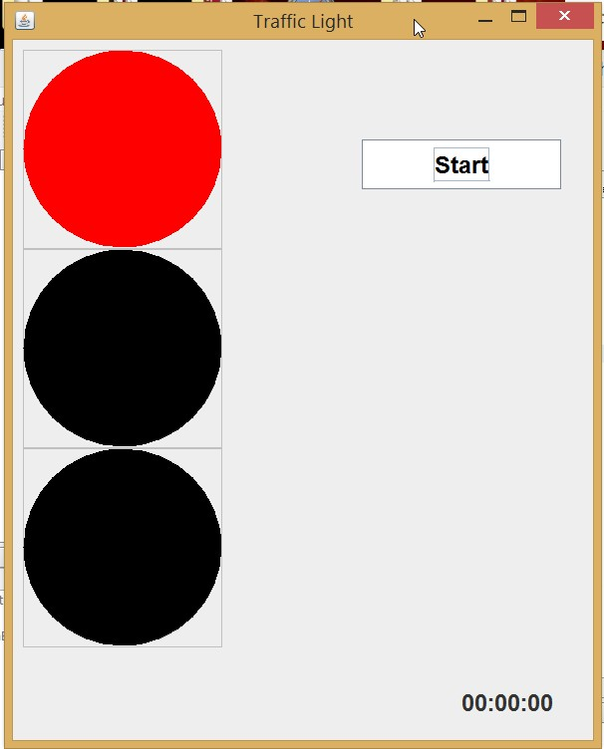
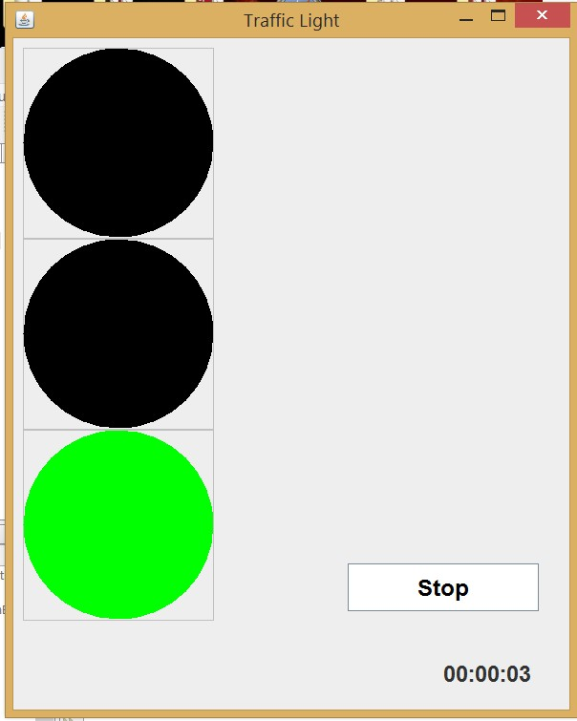

Slide 5
Another Case Study
Currency Converter
The application converts US dollars into one of the four currencies selected by the user: Brazilian reals, Canadian dollars, European Union euros, and Japanese yen. A user is expected to select a country, enter the amount to convert and then press the ‘Compute’ button. The application then displays the equivalent currency in the selected country’s currency units.

Slide 6
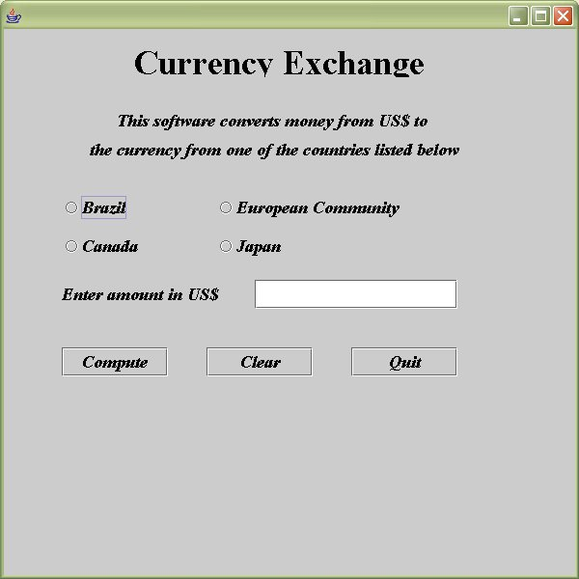

Slide 7
One more case study
There is an electronic ticket counter for a set of people (e.g., employees of a company). Each person enters the first name, last name, ID number and the department in which he/she works. If all fields match correctly, a ticket is issued to that person (assuming that the payment is taken from their payroll). There is a data store which stores all the four fields for each person as well as whether or not this person has bought a ticket already.

Slide 8
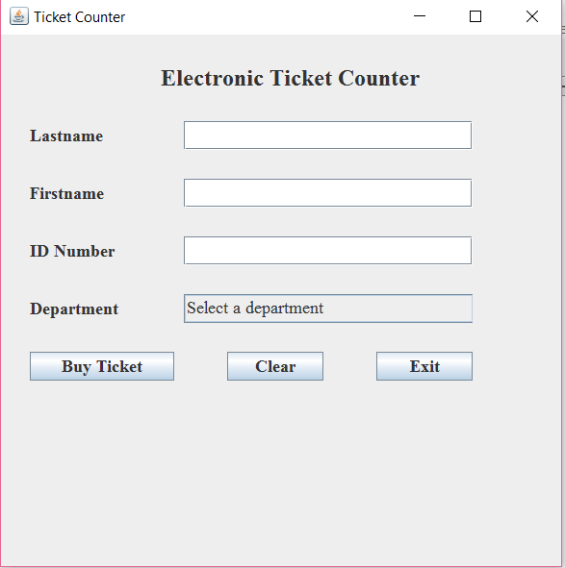

Slide 9
Testing GUI elements
Test every GUI element
Buttons should invoke the correct functionalities associated with them
Menus must be visible and selectable
Drop down boxes should be selectable; i.e., some action must be associated with each item in the drop down box
Some of the drop down boxes may be supposed to be editable
Buttons belonging to a radio-button-group should provide mutually exclusive selections
…

Slide 10
Testing GUI navigation
Also called “GUI walkthrough”
Test the sequence of screens / windows by pressing the appropriate buttons or selecting the appropriate choices
Examples
In Currency Converter, press the ‘Quit’ button to check whether the application terminates
In Traffic Light, press the window closing button and test
Both these applications use single windows. Other applications may use multiple windows in which case GUI walkthrough can be tested by moving from one window to another

Slide 11
Testing GUI navigation / walkthrough (continued)
In some cases, GUI walkthrough also means the sequence of actions to be performed by choosing appropriate GUI controls
Example:
In a GUI for form-filling, the user is required to select a value from a combo box first. The next control or value may be displayed only after the user selects a value from the combo box. For example, the first combo box may display City names and the second combo box may display only the ZIP codes associated with the selected city from the first combo box.

Slide 12
Testing functionalities
Test each observable functionality by providing appropriate input(s) and validating system output(s) against expected output(s)
Use Requirements Document or Use Cases
Examples
In Currency Converter example,
Input a dollar amount in the text box, press ENTER and check the output displayed
In Traffic Light example,
Press the ‘Start’/ ‘Stop’ button and observe what they indeed start/stop the lights
In Ticket Counter example,
Input all correct values and check whether a ticket is issued.

Slide 13
Testing functionalities using State Transition Diagram
State Transition Diagram (STD) helps identifying the valid states of the program
Derived from the requirements / use cases / problem description
Simple semantics
There must be exactly one initial state
There must be one or more final states
Each transition corresponds to an action invoked on the screen
Pressing a button, selecting a menu item, pressing “Enter” key on the keyboard, mouse click (single or double) etc.

Slide 14
Stop
ChangeLight
Display RED
Exit
Stop
Display AMBER
ChangeLight
Exit
Stop
ChangeLight
Display GREEN
Exit
System will be terminated from any state when the window is closed.
State Transition Diagram for Simple Traffic Light

Slide 15
Idle
Quit
Select country
Enter amount
Quit
Clear
Clear
Country
selected
Amount
entered
Clear
Quit
Enter amount
Select country
Both inputs
entered
Quit
Compute
Enter amount
Result
displayed
Quit
Clear
State Transition Diagram for the Currency Converter
Select country

Slide 16
Exercise
Draw the state transition diagram for the Ticket Counter example by yourself.

Slide 17
State Transition Diagram for Currency Converter
Some transitions, when invoked, may not have any effects
Example
The transition ‘select country’ in the state “Country Selected” does not have any effect.
Transition ‘Compute’ in the state “Result Displayed” does not have any effect
These transitions can be modeled as self-looping transitions that originate and end at the same state

Slide 18
Caution
As the number of GUI controls increases, the number of states and number of transitions also increase at a faster rate
Example: The currency converter has 3 buttons but there are more than 15 transitions in its state transition diagram

Slide 19
Shadowing / Invisibility of GUI elements
In a complex GUI application, not all controls are visible or accessible at all times
Examples
In Currency Converter example, the result is displayed only after valid computation is performed
In Ticket Counter example, results are separately displayed for each selection
In Traffic Light example, the stop button is not visible when the system is in idle state
In some GUI, additional menu items are displayed only after valid login entries are provided.

Slide 20
Shadowing / Invisibility … (Continued)
The state transition diagram will help identifying the controls that must be hidden or shadowed
These controls belong to a state that is not directly reachable from the current state
Example
In Currency Converter example, the result string is not computed until both inputs are entered; so it is not reachable from “Idle” state
In Traffic Light example , changing lights is not observed until the start button is clicked

Slide 21
Visual Inspection
Verify that all visible / observable functionalities of the system can be invoked from the GUI
Use Requirements Document or Use Cases
Examples:
In Currency Converter,
User must be able to select a country
User must be able to input an amount to convert
In Traffic Light,
User must be able to start and stop the system manually
In Ticket Counter example,
User must be able to purchase a ticket by entering valid inputs

Slide 22
Visual Inspection (continued)
Consistency Check
Check whether the layout of GUI elements is consistent in all windows
Do menu headers appear in the same order throughout the application?
Example
“Insert” menu may be placed in different places in different windows
Do items in the menu appear in the same order throughout the application?
Example
Check the action of “New” in different Microsoft Windows

Slide 23
Visual Inspection (continued)
Consistency check (continued)
Are buttons for the same action labeled consistently throughout the application?
Example:
“Delete” in one window and “Remove” in another window – Inconsistent
“Add” in one window and “Create” in another window - Inconsistent
Are buttons for the same action placed consistently throughout the application?
Example:
“Exit” on the left bottom corner in one window, and on the right bottom corner on another window – Inconsistent

Slide 24
Visual Inspection (continued)
Consistency check (continued)
Some common mistakes
Missing navigation mechanism to go forward or backward
Example:
Missing “Back” or “Next” buttons or arrows
Missing “Cancel” button or menu
Missing “Clear” button or mechanism for textual inputs
Different fonts, colors, styles etc. on different screens
Example:
One screen may have bigger fonts and bright color, another may have smaller fonts and dark color

Slide 25
Visual Inspection (continued)
Consistency check (continued)
Some common mistakes
Missing confirmation or error messages
Example
There is no action on the screen when the user presses “Submit”
The application does not ask again when the user presses “Delete”
Inconsistent messages
Example
“This item is deleted” at one place “This item is erased” at another place
Messages are not adequately detailed
Inconsistent fonts or colors throughout the application

Slide 26
Usability Testing
Test whether the GUI is easy-to-learn and easy-to-use
Experts advice
Survey from potential users
Compare it to previous and/or competitors’ products
Check whether the on-line help system, if any, is correct with respect to the functionalities implemented
…

