Slide 1
Combinatorial Testing

Slide 2
Some definitions from IEEE
Error
A mistake made by a developer, possibly in the code
The term ‘bug’ is also used to refer to the same situation
Fault
a fault is the result of an error
a fault is the representation of an error (the mode of expression: text, graph, source code, …)
Failure
An observation of the fault by the user of the system
A fault in code may result in zero or more failures

Slide 3
Rationale
Given a program/functionality with N parameters, most failures are triggered by a single parameter value or interactions between a relatively small number of parameters (usually, less than six).
Most software failures often involve interactions between parameters of the program/functionality.
Combinatorial testing is used to find faults due to the combined use of two or more parameters.
NIST report, 2010

Slide 4
T-Way
A t-way interaction fault is a fault that is triggered by a certain combination of t input values
A simple fault is a t-way fault where t=1; a pairwise fault is a t-way fault where t=2
In practice, a majority of software faults consist of simple and pairwise faults

Slide 5
T-way combinatorial testing
Given ‘N’ parameters for a program/functionality, N ≥ 2,
The test cases table for ‘t-way combinatorial testing’ has ‘N’ columns (one for each parameter) such that any ‘t’ columns of the table (N ≥ t) will contain all combinations of the ‘N’ parameters.
Indirectly, the test cases table ensures every possible interactions of ‘t’ parameters at a time.
The major advantage of combinatorial testing is that the number of test cases T is reduced to a very small percentage of the number of test cases for exhaustive/worst case scenario (sometimes, even less than 1%)

Slide 6
Problem 1 – A generic application
Suppose we have an application that is intended to
run on any one of the following operating systems – Windows 10, Apple iOS, Red Hat Linux
run on any one of the following browsers – Microsoft Edge, Firefox
use one of the two network protocols – IPv4, IPv6
run on a machine with one of the two processors – Intel, AMD
use one of the databases – MySQL, Sybase, Oracle
An exhaustive testing process requires 3 * 2 * 2 * 2 * 3 = 48 possible test cases
This type of problem is called “configuration parameter” problem

Slide 7
Problem 2 – Automated Ticket Counter
An automated ticket counter sells tickets for movies with the following parameters: Date (seven possible dates covering one week), Time (four possible show times), Movie (one of five movies) and Ticket type (adult or child). The number of possible inputs will be
7 * 4 * 5 * 2 = 280
Exhaustive testing of all inputs take a lot of time.
This type of problem is called “input parameter” problem. The number of values for an input parameter may be very large.
Use Equivalence partitioning/boundary value analysis

Slide 8
Pairwise Testing
Also called “All-Pairs Testing”
A t-way combinatorial testing technique where t = 2
A combinatorial method of software testing that, for each pair of input parameters to a system (typically, a software algorithm), tests all possible discrete combinations of those parameters. Using carefully chosen test vectors, this can be done much faster than an exhaustive search of all combinations of all parameters, by "parallelizing" the tests of parameter pairs.
Wikipedia, Nov 2017

Slide 9
Pairwise Testing (continued)
Several case studies show that pairwise testing identified most of the errors and significantly reduced testing efforts
Originally developed at MIT and used by
Brownlie of AT&T
NIST

Slide 10
Justification from a case study
A study by the National Institute of Standards and Technology published by Wallace and Kuhn (see the references) analyzed the reason for software defects in recalled medical devices. They analyzed 15 years of medical data. The study concluded that 98% of reported defects could have been detected by using pairwise testing.

Slide 11
How much reduction?
© SoftwareCentral, Sep 2016
Notes:
2^7 = 128 A*B = 2*2 B*A = 2*2 = 8

Slide 12
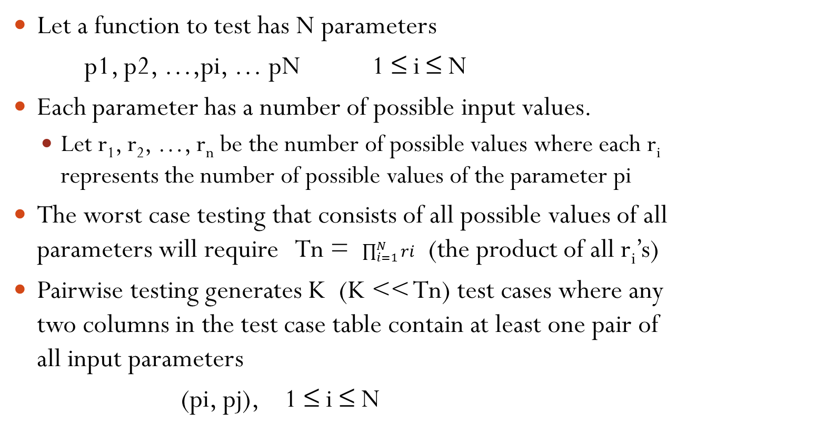
A formal definition of Pairwise Testing
Let a function to test has N parameters
p1, p2, …,pi, … pN 1 ≤ i ≤ N
Each parameter has a number of possible input values.
Let r₁, r₂, …, r_{n} be the number of possible values where each r_{i} represents the number of possible values of the parameter pi
The worst case testing that consists of all possible values of all parameters will require Tn = $\prod_{i=1}^{N}{ri}$ (the product of all r_{i}’s)
Pairwise testing generates K (K << Tn) test cases where any two columns in the test case table contain at least one pair of all input parameters
(pi, pj), 1 ≤ i ≤ N

Slide 13
Example 1
Consider three input parameters X, Y and Z each having two possible values as below:
X → {X1, X2}
Y → {Y1, Y2}
Z → {Z1, Z2}
Number of possible combinations = 2 * 2 * 2 = 8
This can be reduced to only 4 by using all pairs technique. See the next slide

Slide 14
Example 1 (continued)
X | Y | Z
X1 | Y1 | Z1
X1 | Y1 | Z2
X1 | Y2 | Z1
X1 | Y2 | Z2
X2 | Y1 | Z1
X2 | Y1 | Z2
X2 | Y2 | Z1
X2 | Y2 | Z2
X | Y | Z
X1 | Y1 | Z1
X1 | Y2 | Z2
X2 | Y2 | Z1
X2 | Y1 | Z2

Slide 15
Example 2
Consider 3 inputs A, B, C.
Assume A has two possible values – A1 and A2
B has 3 possible values – B1, B2 and B3
C has two possible values – C1 and C2
Exhaustive combinations approach requires 2 x 2 x 3 = 12 test cases
Pairwise testing requires only 6 cobinations
See the table in the next slide

Slide 16
Example 2 (continued)
A | B | C
A1 | B1 | C1
A1 | B2 | C2
A1 | B3 | C1
A2 | B1 | C2
A2 | B2 | C1
A2 | B3 | C2

Slide 17
Notation used in pairwise testing
Called ‘Orthogonal Array’
Notation: L_{r}C₁¹C₂¹…C_{n}¹
where
‘r’ represents the number of rows in the test cases table
which also indicates the number of test cases to be
generated
‘C_{i}’ represents the number of possible values for the i^{th}
input
If two inputs ‘i’ and ‘j’ have same number of possibilities, i.e., C_{i} = C_{j}, then it can be represented as ‘C_{i}^{2’} instead of ‘C_{i}¹C_{j}^{1’}

Slide 18
Serial number | Parameter 1 | Parameter 2
1 | P1 | P1
2 | P2 | P1
3 | P1 | P2
4 | P2 | P2
2 input parameters, each having 2 possible values
Represented by the notation L₄2¹2¹ or L₄2²

Slide 19
Properties of Orthogonal Array
Every pair of columns i and j indicate all possible pairs of i^{th} and j^{th} input parameters
If a pair of input parameters is duplicated in another row, then every pair of input parameters must be duplicated in the table
Forces the table to be “balanced”

Slide 20
Orthogonal Array
L₉3⁴ array
S.No | 1 | 2 | 3 | 4
1 | 1 | 1 | 1 | 1
2 | 1 | 2 | 2 | 2
3 | 1 | 3 | 3 | 3
4 | 2 | 1 | 2 | 3
5 | 2 | 2 | 3 | 1
6 | 2 | 3 | 1 | 2
7 | 3 | 1 | 3 | 2
8 | 3 | 2 | 1 | 3
9 | 3 | 3 | 2 | 1
Array with 9 rows and 4 columns
Value in each cell ranges from 1 to 3.
Every pair of columns contains all possible pairs of input values between 1 and 3

Slide 21
L₁₈3⁵ array
S.No | 1 | 2 | 3 | 4 | 5
1 | 1 | 1 | 1 | 1 | 1
2 | 1 | 2 | 3 | 3 | 1
3 | 1 | 3 | 2 | 3 | 2
4 | 1 | 2 | 2 | 1 | 3
5 | 1 | 3 | 1 | 2 | 3
6 | 1 | 1 | 3 | 2 | 2
7 | 2 | 2 | 2 | 2 | 2
8 | 2 | 3 | 1 | 1 | 2
9 | 2 | 1 | 3 | 1 | 3
10 | 2 | 3 | 3 | 2 | 1
11 | 2 | 1 | 2 | 3 | 1
12 | 2 | 2 | 1 | 3 | 3
13 | 3 | 3 | 3 | 3 | 3
14 | 3 | 1 | 2 | 2 | 3
15 | 3 | 2 | 1 | 2 | 1
16 | 3 | 1 | 1 | 3 | 2
17 | 3 | 2 | 3 | 1 | 2
18 | 3 | 3 | 2 | 1 | 1
Balanced Orthogonal array

Slide 22
S.No | 1 | 2 | 3 | 4 | 5 | 6 | 7 | 8
1 | 1 | 1 | 1 | 1 | 1 | 1 | 1 | 1
2 | 1 | 1 | 2 | 2 | 2 | 2 | 2 | 2
3 | 1 | 1 | 3 | 3 | 3 | 3 | 3 | 3
4 | 1 | 2 | 1 | 1 | 2 | 2 | 3 | 3
5 | 1 | 2 | 2 | 2 | 3 | 3 | 1 | 1
6 | 1 | 2 | 3 | 3 | 1 | 1 | 2 | 2
7 | 1 | 3 | 1 | 2 | 1 | 3 | 2 | 3
8 | 1 | 3 | 2 | 3 | 2 | 1 | 3 | 1
9 | 1 | 3 | 3 | 1 | 3 | 2 | 1 | 2
10 | 2 | 1 | 1 | 3 | 3 | 2 | 2 | 1
11 | 2 | 1 | 2 | 1 | 1 | 3 | 3 | 2
12 | 2 | 1 | 3 | 2 | 2 | 1 | 1 | 3
13 | 2 | 2 | 1 | 2 | 3 | 1 | 3 | 2
14 | 2 | 2 | 2 | 3 | 1 | 2 | 1 | 3
15 | 2 | 2 | 3 | 1 | 2 | 3 | 2 | 1
16 | 2 | 3 | 1 | 3 | 2 | 3 | 1 | 2
17 | 2 | 3 | 2 | 1 | 3 | 1 | 2 | 3
18 | 2 | 3 | 3 | 2 | 1 | 2 | 3 | 1
L₁₈2¹3⁷ array

Slide 23
Using Orthogonal Arrays for Testing
Step 1:
Identify the input parameters
Step 2:
Determine the number of choices for each input parameter
Step 3:
Determine an orthogonal array with one column for each input parameter and values in each column corresponding to the range of values for that input parameter

Slide 24
Using Orthogonal Arrays for Testing (continued)
Step 4:
Replace the number in each cell by the corresponding value in the input domain
Step 5:
Construct test cases using the orthogonal array

Slide 25
Example
Construct the orthogonal array for the following problem:
A web-based application has been written to work with eight different browsers – IE 5.0, 5.5, 6.0, Netscape 6.0, 6.1, 7.0, Mozilla 1.1 and Opera 7. The software runs three different plug-ins – RealPlayer, MediaPlayer or none; runs on six different client operating systems – Windows 2000, ME, XP, Linux, Mac OS X, and Solaris 9. The application resides in three different servers – IIS, Apache and WebLogic, running three different server operating systems – Windows 2000, XP and Linux.
See Lee Copeland’s book for the table

Slide 26
Observations
The problem requires L_{x}8¹6¹3³ orthogonal array
The closest bigger orthogonal array is L_{x}8²4³
The table contains 64 rows
Additional entries are filled up by the tester
Not all combinations of input parameters are represented in the array
Only all possible pairs are included in the array

Slide 27
Allpairs Algorithm
Constructs all possible pairs of input parameters directly
No constraints as in orthogonal arrays
For the same case study, this algorithm generates only 48 rows in the table
The table generated in this algorithm is “unbalanced”

Slide 28
Another case study

Slide 31
All pair test cases for problem 1 – A generic application
Test case # | OS | Browser | Protocol | Machine | Database
1 | Windows 10 | Mic. Edge | IPv4 | Intel | MySQL
2 | Windows 10 | Firefox | IPv6 | AMD | Sybase
3 | Windows 10 | Mic. Edge | IPv6 | Intel | Oracle
4 | iOS | Firefox | IPv4 | AMD | MySQL
5 | iOS | Mic Edge | IPv4 | Intel | Sybase
6 | iOS | Firefox | IPv4 | Intel | Oracle
7 | Red Hat | Mic. Edge | IPv6 | AMD | MySQL
8 | Red Hat | Firefox | IPv4 | Intel | Sybase
9 | Red Hat | Firefox | IPv4 | AMD | Oracle
10 | iOS | Firefox | IPv6 | AMD | Oracle

Slide 32
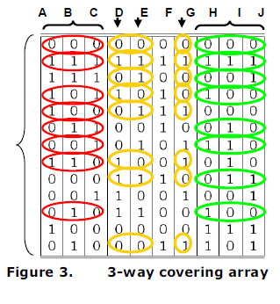
T-way combinatorial testing (revisited)
Assume a program/functionality with 10 Boolean input parameters, here is a test cases table for 3-way combinatorial testing
Exhaustive testing of this program requires 2¹⁰ = 1024 test cases
© NIST 2010

Slide 33
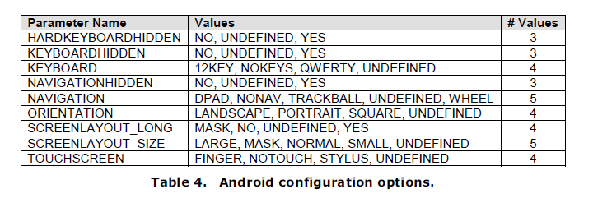
Another example
Android configuration options
Exhaustive testing of an android configuration requires
3*3*4*3*5*4*4*5*4 = 172,800 test cases

Slide 34
Combinatorial test cases for Android configuration
© NIST, 2010

Slide 35
Significant reduction of test cases
The number of test cases in a t-way combinatorial testing is proportional to
v^{t} log(n)
where ‘v’ is the maximum number of possible values for any parameter, and ‘n’ is the number of parameters
As the number of parameters ‘n’ increases, the number of test cases only increased by ‘log(n)’. However, it exponentially increases with ‘t’.
Most practical applications use a maximum of t = 6.

Slide 36
Some pairwise testing tools
AllPairs from James Bach (free)
http://www.satisfice.com/tools.shtml
PICT (Pairwise Independent Combinatorial Testing) Tool
https://github.com/Microsoft/pict
Jenny
http://burtleburtle.net/bob/math/jenny.html
ACTS (Advanced Combinatorial Testing System) from NIST
http://csrc.nist.gov/groups/SNS/acts/documents/comparison-report.html#acts

Slide 37
References
Lee Copeland, “A Practitioner’s Guide to Software Test Design”, Artech House Publishers, 2004, ISBN: 1-58053-791-X
A.S. Hedayat et al., “Orthogonal Arrays: Theory and Applications”, Springer-Verlag, NY, 1999.
Black Rex, Pragmatic Software Testing: Becoming an Effective and Efficient Testing Professional, Wiley, NY, 2004, ISBN: 978-0-470-12790-2.

Slide 38
References (continued)
J. Czerwonka, “Pairwise Testing in Real World”, Proceedings of the 24th Pacific Northwest Software Quality Conference, 2006.
W. Uthaileang et al., “Pair-wise Testing Applied with Online Registration”, 4th Joint International Conference on Information and Communication Technology (JICTEE-2014), 5-8 March 2014, Chiang Rai, Thailand.
Practical Software Testing, Technical Report SP 800-142, National Institute of Standards and Technology (NIST), 2010.

Slide 39
References (continued)
G.T. Daich, New Spreadsheet Tool Helps Determine Minimal Set of Test Parameter Combinations, CrossTalk, Aug 2003, pp. 26-30.
D. R. Kuhn, D.R. Wallace, and A.J. Gallo Jr., Software Fault Interactions and Implications for Software Testing, IEEE Transactions on Software Engineering, Vol. 30, No. 6, June 2004.

